Slide 1
Gas Absorption-Desorption or Stripping

Slide 2
Gas Absorption is an operation in which a gas mixture is contacted with a liquid for the purposes of preferentially dissolving one or more components of the gas and to provide a solution of them in the liquid.
Removal of Acid gases (H2S & CO2) from Natural Gas by absorption into Alkanolamines (MEA, DEA).
Removal of CO2 from reformer gas in the production of Hydrogen
Removal of NH3 and Benzene & Toluene from Coke oven gas
Absorption operations require mass transfer from gas stream to liquid.
When the mass transfer occurs in the opposite direction, i.e., from liquid to gas, the operation is called Desorption or Stripping.
Removal of dissolved acid gases from rich alkanolamine solution by steam
Removal of benzene & toluene from rich hydrocarbon oil

Slide 3
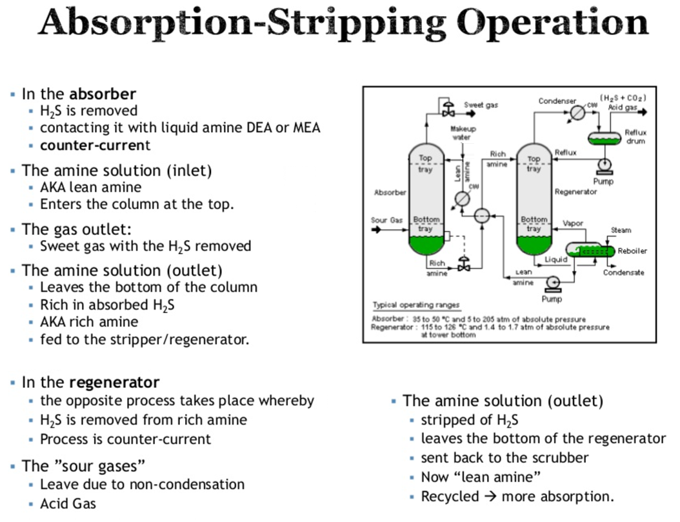

Slide 4
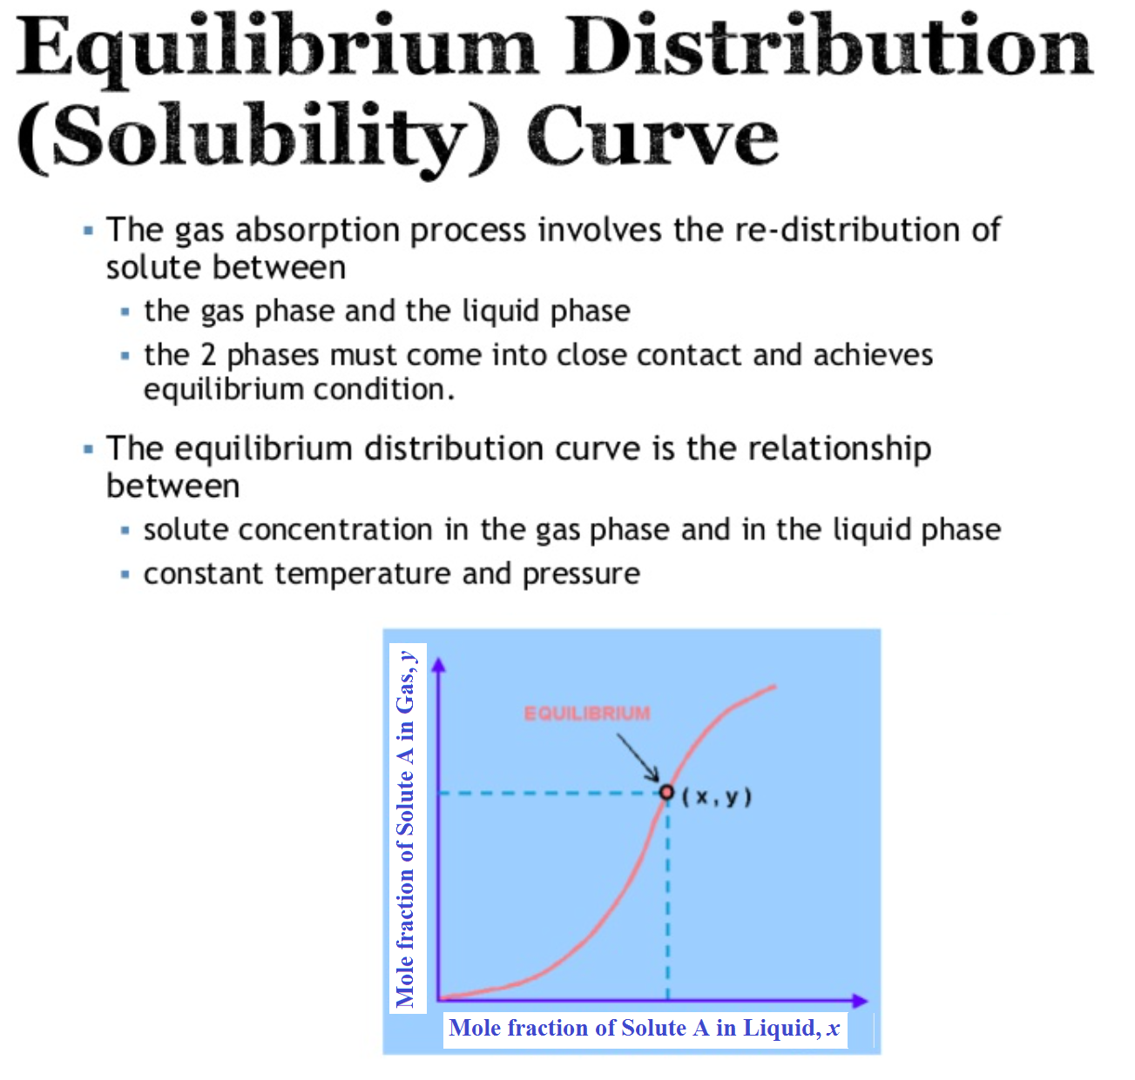

Slide 5
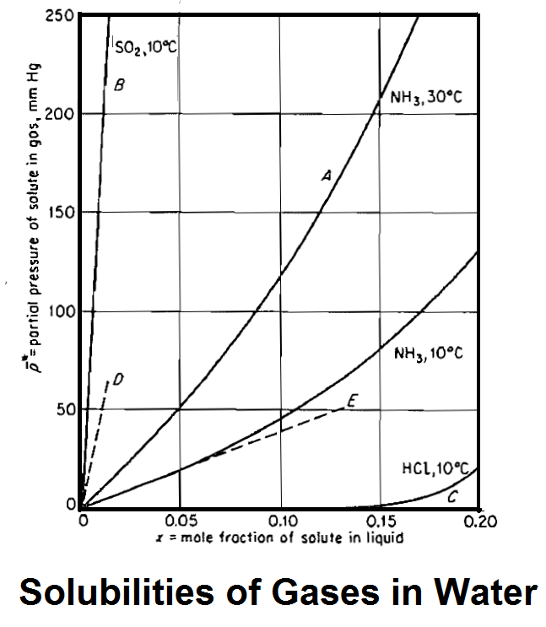

Slide 6
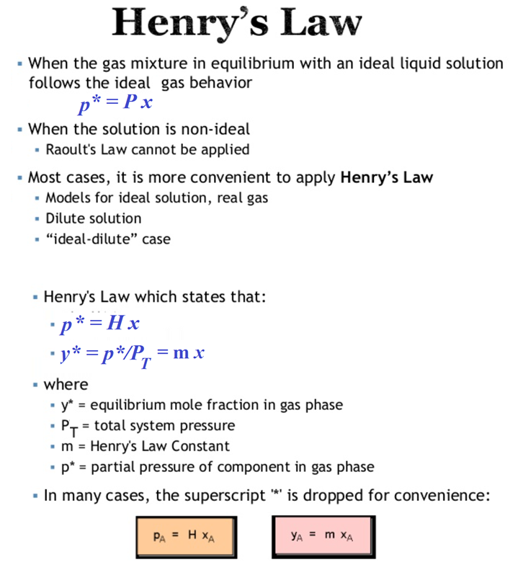

Slide 7
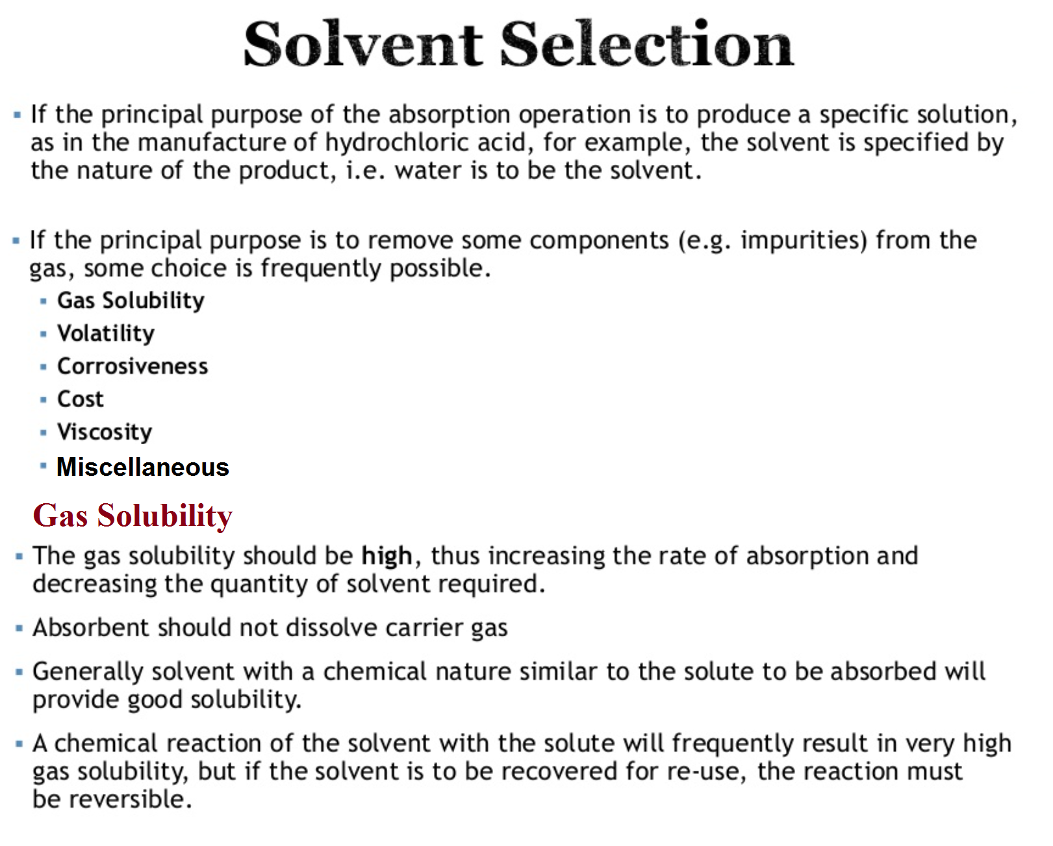

Slide 8
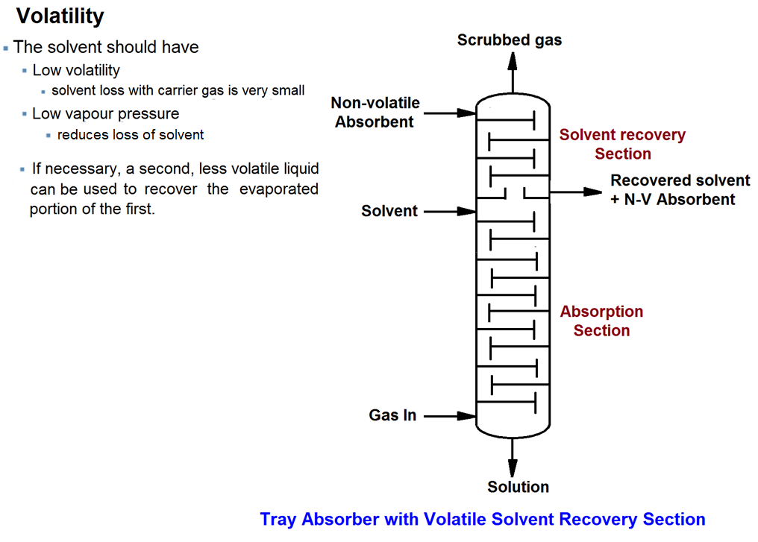

Slide 9
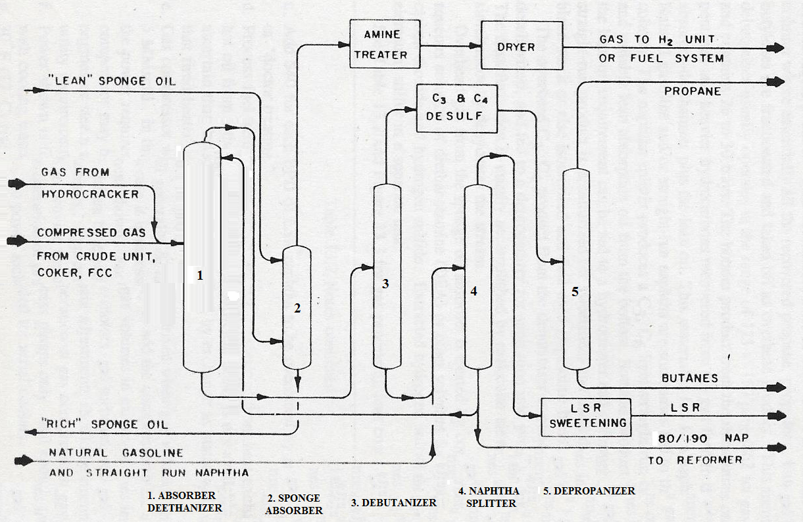
Refinery Gas Processing Unit

Slide 10
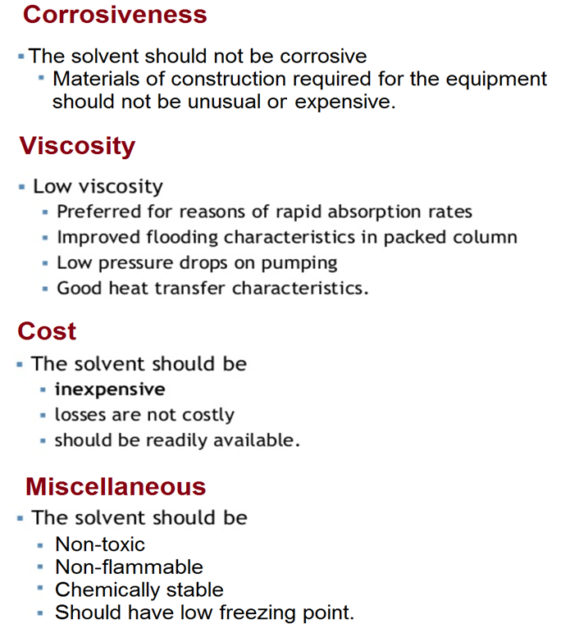

Slide 11
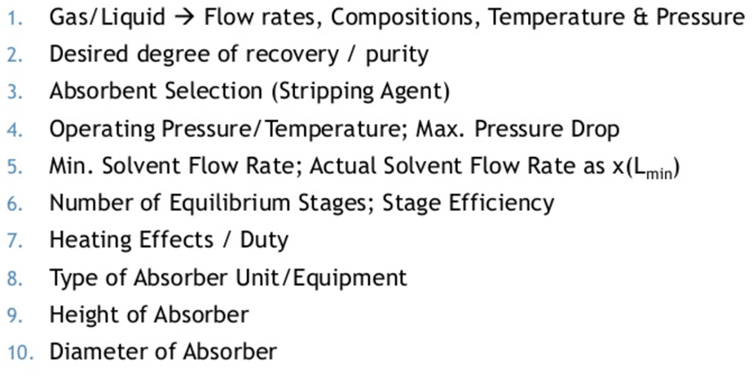
Design of Absorber/Stripper
Design Steps :

Slide 12
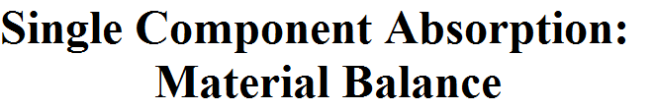
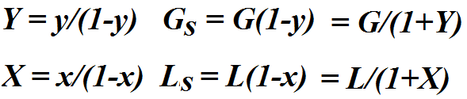
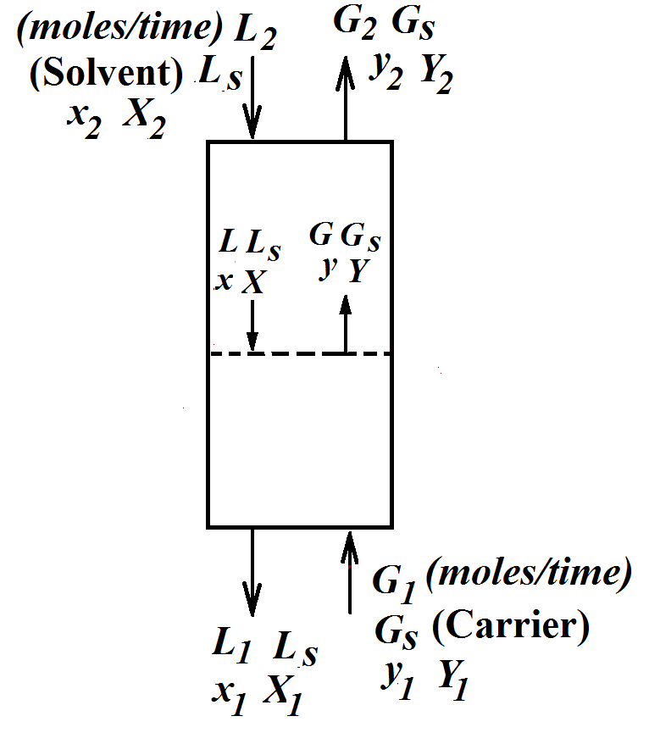
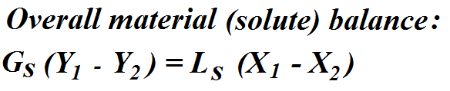
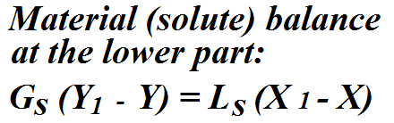

Slide 13
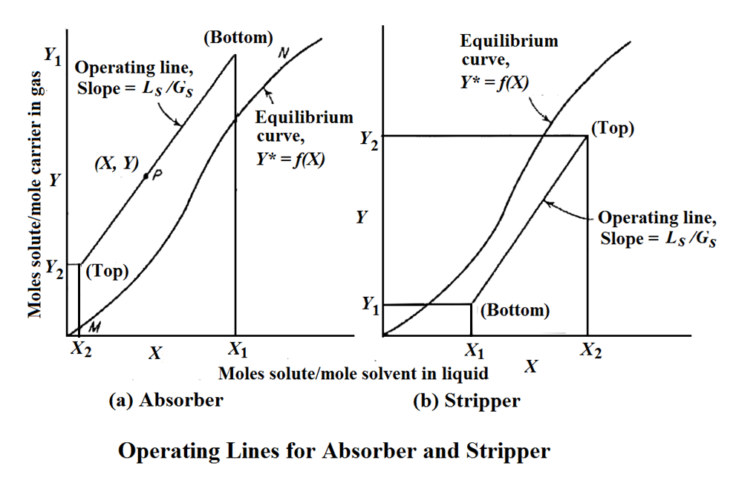

Slide 14
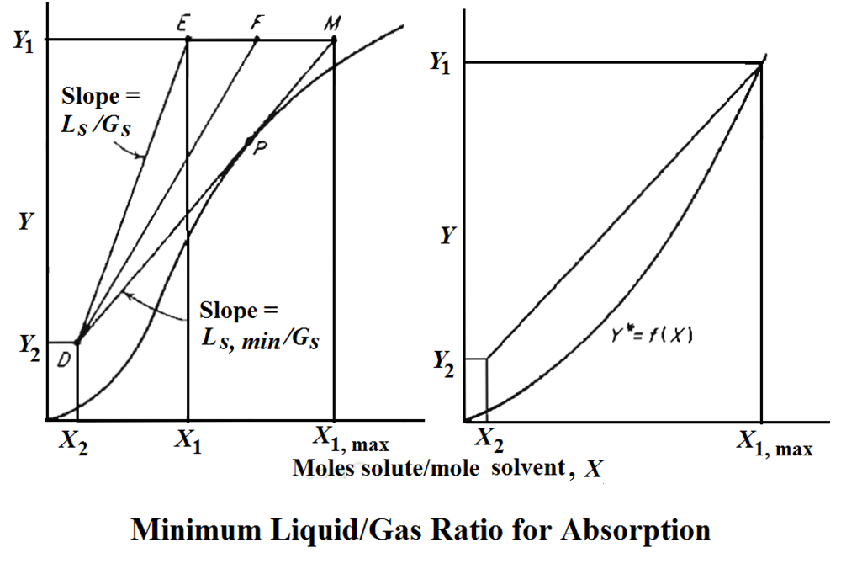

Slide 15
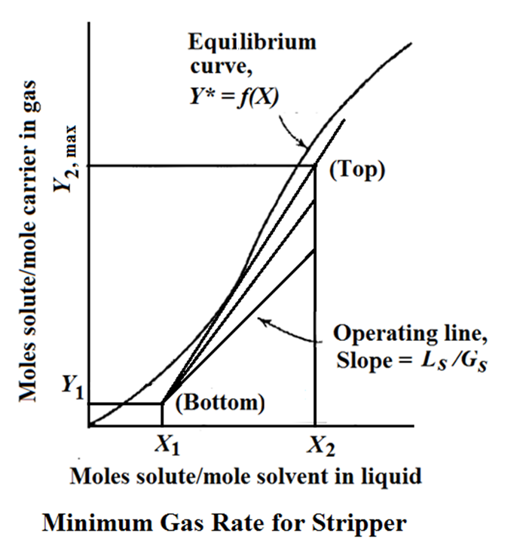

Slide 16
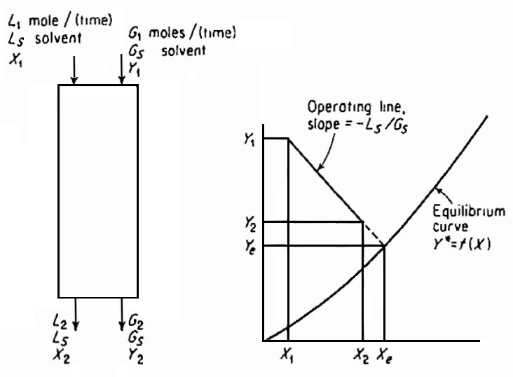
Co-current Absorber

Slide 17
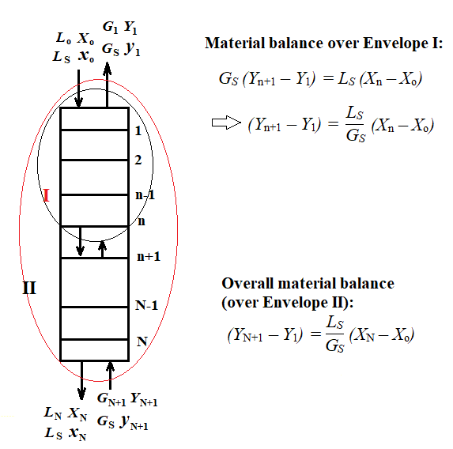
Counter-current Multistage Gas Absorption
One Component Transferred

Slide 18
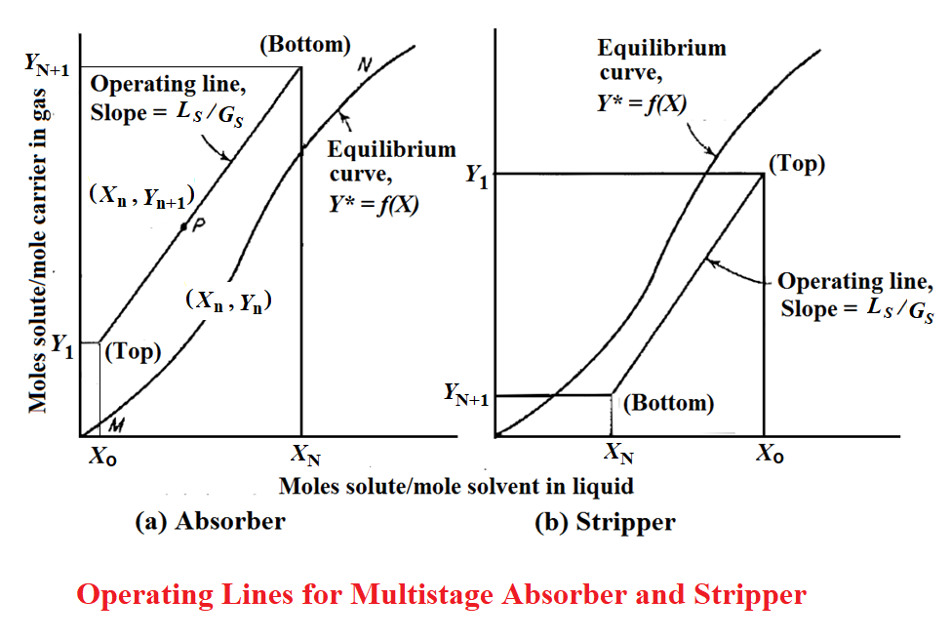

Slide 19
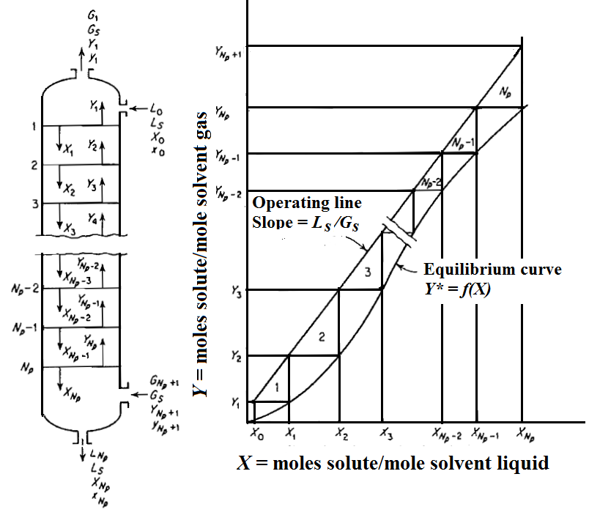
Determination of Number of Stages in Counter-current Multistage Absorber (Tray Tower)

Slide 21
Dilute Gas Mixtures
Absorption:
For A ≠ 1
For A = 1
Stripping:
For S ≠ 1
For S = 1:
Kremser-Brown-Souders (or simply Kremser) Equations

Slide 22
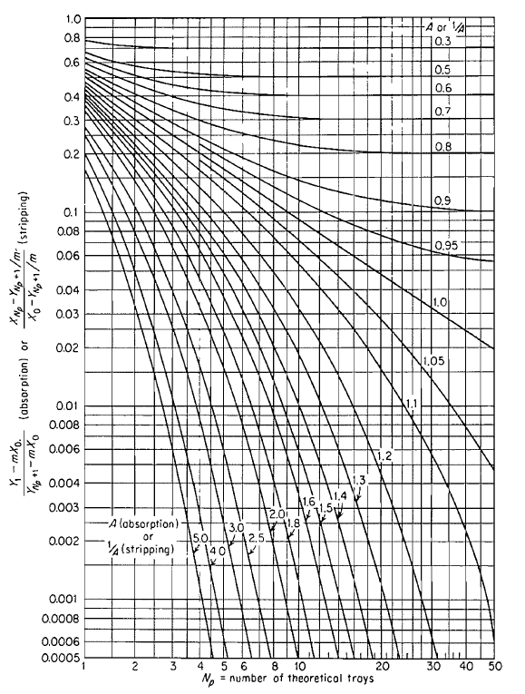

Slide 23
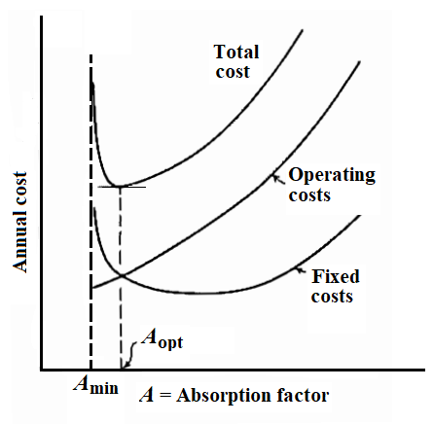
Determination of most economical (Optimum) Absorption factor (Aopt)

Slide 25
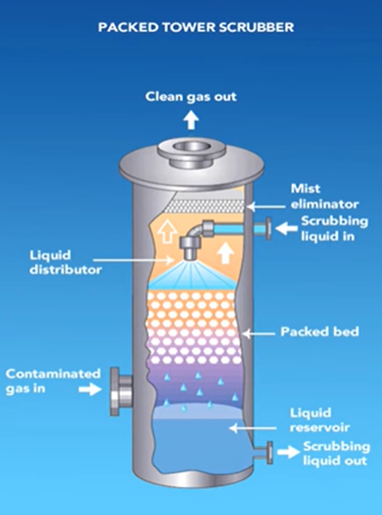
Design of Continuous Contact Equipment
(Packed Towers)

Slide 26
Counter-current contactors such as packed and spray towers operate in a different manner from the plate towers in that the fluids are in contact continuously in their path through the tower, rather than intermittently. Thus, in a packed tower the liquid and gas compositions change continuously with height of packing. Every point on an operating line, therefore, represents conditions found somewhere in the tower, whereas for tray towers, only the isolated points on the operating line corresponding to locations between two consecutive trays have real significance.
Height Equivalent to a Theoretical Tray or Plate (HETP)
A simple method for designing packed towers, introduced many years ago, ignores the differences between stagewise and continuous contact. In this method, the number of theoretical trays or plates required for a given change in concentration is computed by the methods followed for tray towers. This is then multiplied by a quantity, the height equivalent to a theoretical tray or plate (HETP) to give the required height of the packing to do the same job. The HETP must be an experimental determined quantity characteristic for each packing. Unfortunately, it is found that the HETP varies, not only with the type and size of the packing but also very strongly with flow rates of each fluid and for every system with concentration as well, so that an enormous amount of experimental data would have to be accumulated to permit utilization of the method. The difficulty lies in the failure to account for the fundamentally different action of tray and packed towers, and the method has now largely been abandoned.

Slide 27
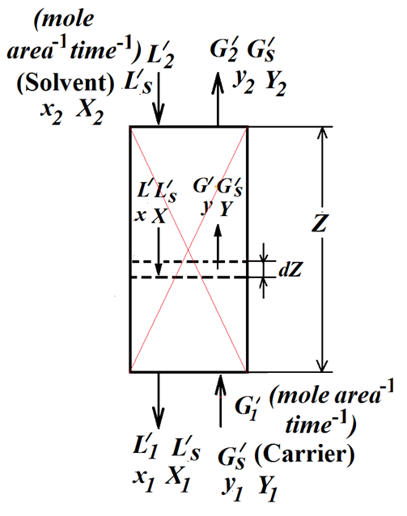
Design of Packed Tower for Single Component Absorption
S = a Z or, dS = a dZ …. (1)
- d(G′ y) = N_{A} dS = N_{A} a dZ .... (2)
Again, - d(G′ y) = - G′ dy - y dG′ .... (3)
But - dG′ is the decrease in the total amount of gas, i.e., the amount of gas absorbed. Therefore,
- dG′ = N_{A} a dZ .... (4)
The flux (N_{A}) can be expressed as:
N_{A} = k_{y} (y – y_{i} ) .... (5)
From equations (2), (3), (4) and (5) we get,
- G′ dy = y dG′ + N_{A} a dZ = (1 - y) N_{A} a dZ
=> - G′ dy = k_{y} a (1 - y) (y – y_{i} ) dZ …. (6)
Alternatively,

Slide 28
Equation (6) on rearrangement and integration gives:
…. (7)
Equation (7) can be used to calculate the height of the packing.

Slide 29
Design Procedure Based on “Transfer Unit”
We have got the expression for height of the packed tower as
.... (7)
It has been observed that the mass transfer coefficient is nearly proportional to G^{0.8} in turbulent flow. From experimental data on a large number of columns, it has been found that the quantity G′/k_{y}a (1-y)_{iM} remains fairly constant all through the tower. Then equation (7) can be expressed as
.... (8)
Where,
.... (9)
Z = H_{tG} x N_{tG} .... (10)

Slide 30
H_{tG}
=
... (11a)
N_{tG}
=
... (11b)
Height of a transfer unit (H_{tG}) indicates inversely the relative ease with which a tower can accomplish mass transfer. Thus the more the mass transfer coefficient and specific interfacial area, the more effective is the tower for mass transfer and less is the height of a transfer unit.
Number of transfer unit (N_{tG}) indicates the difficulty involved with the degree of separation desired. The more is the degree of separation desired, the less will be the driving force available and higher will be the number of transfer units.
Similarly, liquid phase transfer units are expressed as:
... (12a)
... (12b)

Slide 31
Procedure for Determining Tower Height
H_{tG}
=
When the variation of gas flow rate over the column is considerably large, an average value of it may be used as:
G′ = (G₁′ + G₂′)/2.
Similarly, as y_{BM} varies with height an average value is taken by calculating y_{BM} at the bottom and top and taking the arithmetic average as:
y_{BM} = [(y_{BM})₁ + (y_{BM})₂/2.
N_{tG}
=

Slide 32
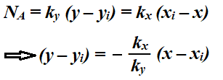
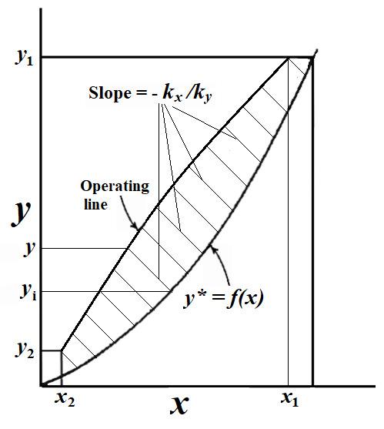
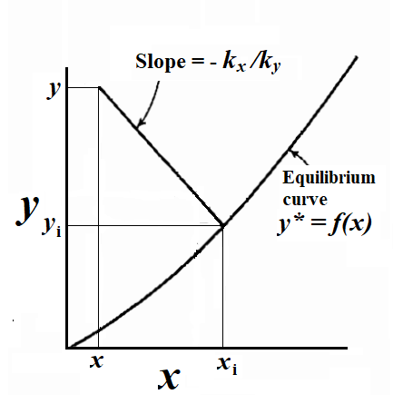
Determination of interfacial concentration
Determination of interfacial concentrations
at different locations of the contactor

Slide 33
Design Procedure Based on Overall Coefficients
N_{A} = K_{G} (p – p*)= K_{L}(C* – C) .... (13)
= K_{y} (y – y*) = K_{x} (x* – x) .... (14)
.... (15)
Again, the above expression may be written as the product of two terms, one is the height of transfer unit based on overall coefficient and the other the number of transfer unit based on overall driving force.
.... (16)
.... (17)
Where,
Z = H_{tOG} x N_{tOG}
.... (18)

Slide 34
…. (19a)
For considerably large variation of gas flow rate over the column, an average value of it may be used as:
G′ = (G₁′ + G₂′)/2.
Similarly, as y*_{BM} varies with height an average value is taken by calculating y*_{BM} at the bottom and top and taking the arithmetic average as: y*_{BM} = [(y*_{BM})₁ + (y*_{BM})₂/2.
…. (19b)
Similarly,
…. (19c)
…. (19d)

Slide 35
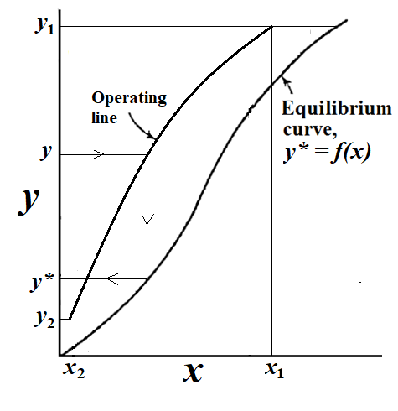
Determination of overall driving force

Slide 36
Simplified Design Procedure for Moderately Concentrated Gas
The number of transfer unit on overall gas phase resistance basis is:
…. (19b)
The above expression can be simplified by replacing log mean average with the
arithmetic average as:
The expression for N_{tOG} becomes:
=
…. (20a)
The first integral has to be evaluated either graphically or numerically.
Similarly,
…. (20b)

Slide 37
Further Simplified Design Procedure for Lean Gas
In case of lean gas, it is easier to find out H_{tOG}.
In that case, y*_{BM} = 1 and the expression for H_{tOG} becomes
H_{tOG} = G′/K_{y} a.
Moreover, the gas flow rate is more or less constant throughout the tower for dilute gas so that G′ = G₁′ = G₂′ = G_{S}′.
Again, the expression for number of transfer unit can be further simplified as
…. (21)
If, however, the equilibrium line is linear (which very often occurs in low concentration range), then the expression for N_{tOG} becomes
…. (22)
Where,
…. (23)
is the logarithmic average of the concentration differences at the ends of the tower.

Slide 38
Definition of Transfer Unit
…. (22)
A quantitative significance of N_{tOG} can be given from the above equation, applicable for dilute systems. In fact, this is considered as defining equation for transfer unit. In this equation, if we put N_{tOG} =1, then (y₁ – y₂) = (y – y*)_{M}, i.e., Over a single transfer unit, the change in gas concentration is equal to the average driving force.

Slide 39
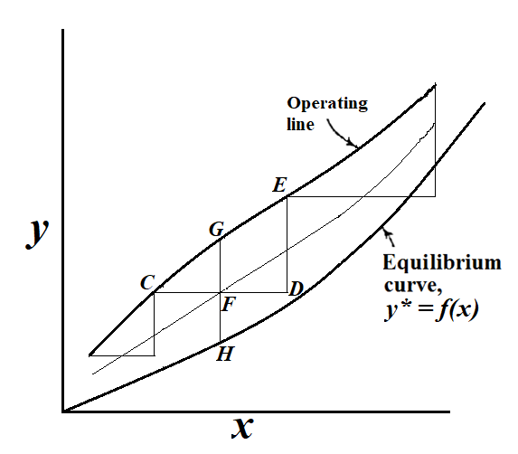
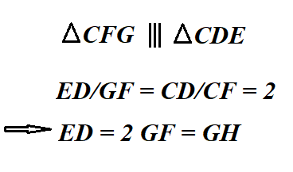
Graphical Construction for Transfer Units
Graphical determination of transfer units

Slide 40
Dilute Solutions
…. (19b)
…. (21)
If the equilibrium curve in terms of mole fractions is linear over the range of compositions
x₁ to x₂, then y* = mx + r. …. (24)
If the solutions are dilute, the operating line can be considered as a straight line as well
…. (25)
so that the driving force (y – y*) is linear in x
y – y* = q x + s …. (26)
where q, r and s are constants.
q = (L/G – m)
s = y2 – (L/G) x2 - r
Therefore, equation (21) becomes
…. (22)

Slide 41
Dilute Solutions, Henry’s Law
…. (21)
If Henry’s law applies, then r in equation (24) is zero so that the equilibrium line becomes
y* = m x
…. (28)
The equation of the operating line is:
…. (25)
Eliminating x from equations (25) and (28) and substituting y* in equation (21), we get
…. (29)
Where, A = L/mG is the absorption factor, in case of absorber.

Slide 42
Now, substituting y* in equation (21)
… (30)

Slide 43
For strippers, the corresponding expression for N_{tOL} is similar.
…. (31a)
…. (31b)
For solutions and cases where Henry’s law applies, prove that the number of overall liquid
phase transfer units for counter-current desorption in packed towers is given by
where the notations have their usual meanings.

Slide 44
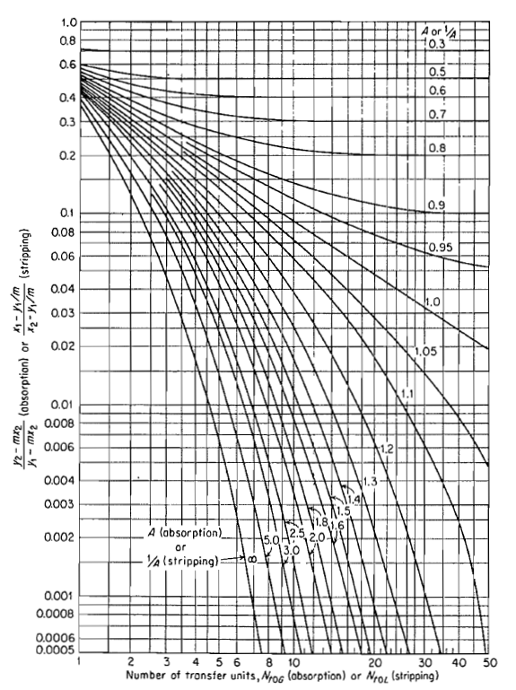
Number of transfer units for absorbers or strippers with
constant absorption or stripping factor

Slide 45
Overall Heights of Transfer Units
When overall number of transfer units are appropriate, the overall heights of transfer units can be synthesized from those for the individual phases through the relationship between overall transfer coefficients and individual transfer coefficients as follows:
…. (32)
And,
…. (33)

Slide 46
If the mass transfer resistance is essentially all in the gas, y_{i} ≈ y*, and
.... (34)
and, for dilute solutions, the concentration ratio of the last equation can be dropped
so as to yield
.... (35)
and
.... (36)
In similar fashion, use of liquid phase overall coefficient yields
.... (37)
.... (38)
and

Slide 47
If the mass transfer resistance is essentially all in the liquid, x_{i} ≈ x*, and
.... (39)
The concentration ratio of the last can be dropped for dilute solutions so that
.... (40)
and
.... (41)

Slide 48
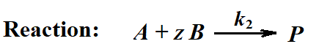
Absorption with Chemical Reaction
Regime – 1: Very Slow Reaction
Regime – 2: Slow Reaction
Regime – 3: Fast Reaction
Regime – 4: Instantaneous Reaction

Slide 49
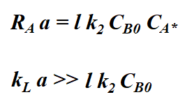
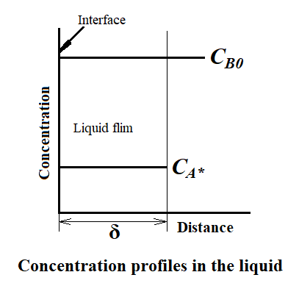
Regime – 1: Very Slow Reaction
Rate of Absorption:
Condition:

Slide 50
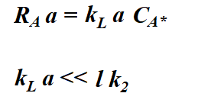
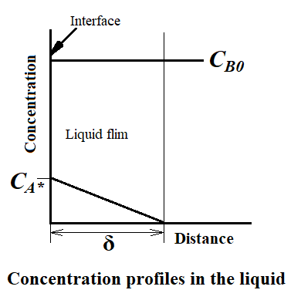
Regime – 2: Slow Reaction
Rate of Absorption:
Condition:
For no reaction within the film
:
Hatta No.: Ha =

Slide 51
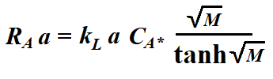
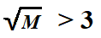
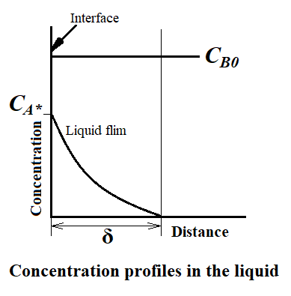
Regime – 3: Fast Reaction
Rate of Absorption:
Condition:

Slide 52
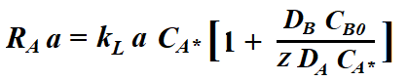
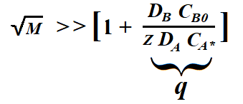
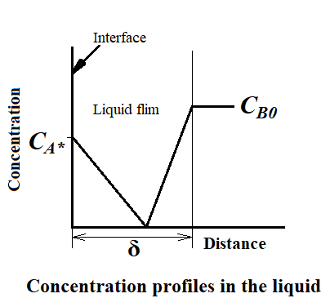
Regime – 4: Instantaneous Reaction
Rate of Absorption:
Condition:

Slide 53
Thank you!

